Slide 1
Governing the Great City
**The Shame of the Cities** - Lincoln Steffens:
Wrote about corruption between city governments and big businesses
Urban Machines
Many utilities were provided by private businesses, not the city government
Political Machines: (See video on Tammany Hall in description)
Tammany Hall, NYC
Controlled many aspects of city government
Provided jobs, food, $, etc. to constituents in exchange for votes and support
George Washington Plunkitt - leader of Tammany Hall, favored “honest graft”
“Boss” Tweed - favored “dishonest graft” - bribery, stole over $200 million, later caught in Cuba due to Thomas Nast!

Slide 2
Attempts to make the cities better
Some mayors (Quincy in Boston) began to build public pools, gyms, playgrounds etc.
Also fought to lower fares on streetcars
Tom Johnson of Cleveland pushed for the city to own the utility companies
Hazen Pingree of Detroit worked to get better streets and public transportation in his city.
The 1900 hurricane that wiped out Galveston led to a new form of city government called the “commission system” – which was more tailored to electing experts to help oversee the rebuilding of the city.

Slide 3
Jacob Riis – How the Other half Lives
Long ago it was said that “one half of the world does not know how the other half lives.” It did not know because it did not care. The half that was on top cared little for the struggles, and less for the fate of those who were underneath, so long as it was able to hold them there and keep its own seat. There came a time when the discomfort and crowding below were so great, and the consequent upheavals so violent, that it was no longer an easy thing to do, and then the upper half fell to inquiring what was the matter. Information on the subject has been accumulating rapidly since, and the whole world has had its hands full answering for its old ignorance.
In New York … the boundary line of the Other Half lies through the tenements. … To-day three-fourths of its people live in the tenements, and the nineteenth century drift of the population to the cities is sending ever-increasing multitudes to crowd them. The fifteen thousand tenant houses that were the despair of the sanitarian in the past generation have swelled into thirty-seven thousand, and more than twelve hundred thousand persons call them home.

Slide 4
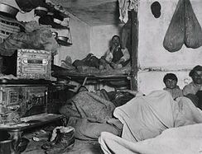
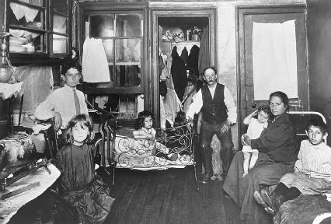
How the Other Half Lives

Slide 5
Cleaning up the Cities
Disease spread through cities quickly - cholera, typhoid fever - led to a clean-water initiative
New sewage and drainage systems were established in large cities
“City Beautiful” movement - sought to increase and improve the number of park spaces
Closing Red Light Districts
Reasons that women entered prostitution:
Low paying jobs, hard economic times, abuse, etc.
Mann Act - made it illegal to transport prostitutes across state lines

Slide 6
Progressive Reform
The Movement for Social Settlements
Hull House - Jane Addams, Chicago, IL, 1889
Helped poor women, immigrants, and children adjust to city life
Provided a bathhouse, day care, etc.
Became instrumental in social work movement
Florence Kelley opened a pediatric clinic at Hull House
Julia Lathrop – proposed creating a separate juvenile court system
Margaret Sanger - Advocated for birth control (which was illegal in many areas)

Slide 7
Progressive Reform
Cities and National Politics
Upton Sinclair - The Jungle (1906)
Helped inspire the Meat Inspection Act and Pure Food and Drug Act (1906)
National Consumer’s League (NCL) - led by Florence Kelley
Advocated laws to protect workers
Triangle Shirtwaist Factory Fire - March 25, 1911
146 employees died - average age was 19
Alfred Smith - NY state legislator and future presidential candidate established a commission to investigate the disaster and helped inspire new laws
Frances Perkins – witnessed the fire. She later became the first woman appointed to a presidential cabinet - Secretary of Labor for FDR

